Slide 1
Direzione centrale salute, politiche sociali e disabilità
WORLD CITIES DAY 2025
Inclusive Urban Futures: Families, Care and Innovation at the Heart of Cities
«Family – oriented Policies & Healthy Habits»
Gianna Zamaro
Friuli Venezia Giulia Autonomous Region Italy
United Nations Headquarters
New York Friday , October 31st, 2025

Slide 2
Direzione centrale salute, politiche sociali e disabilità
What we have done
&
what we are doing
for vulnerable people & families
United Nations Headquarters
New York Friday , October 31st, 2025

Slide 3
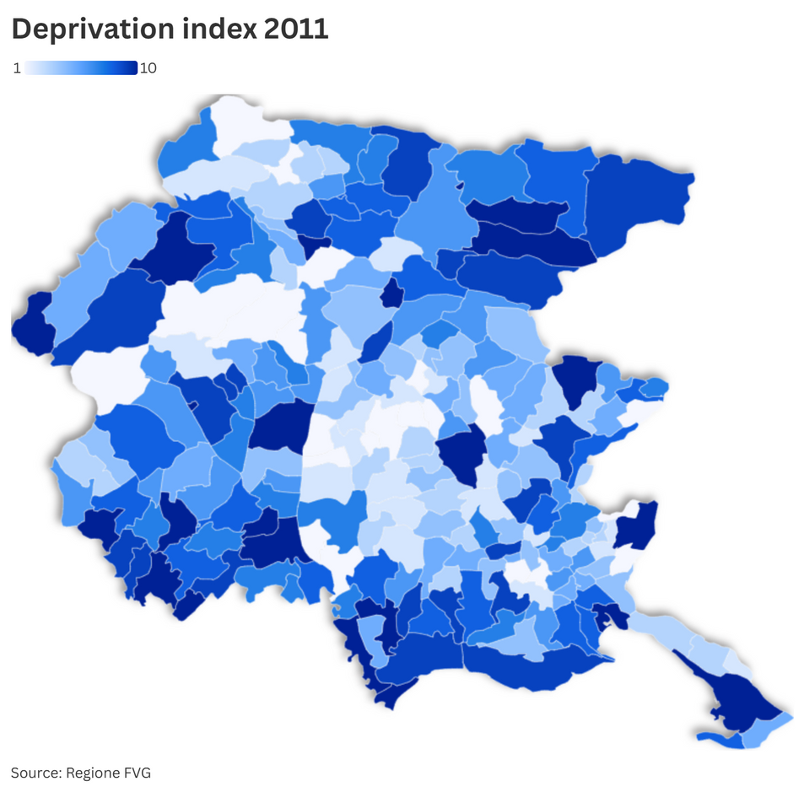
Direzione centrale salute, politiche sociali e disabilità
The regional contest analysis
United Nations Headquarters
New York Friday , October 31st, 2025

Slide 4
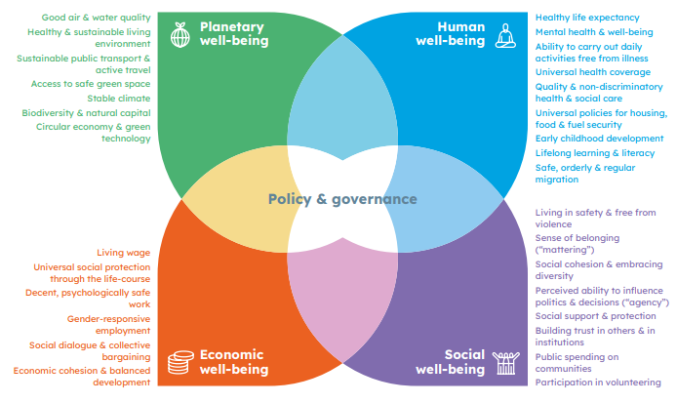
The data and the needs of person & families
Direzione centrale salute, politiche sociali e disabilità
United Nations Headquarters
New York Friday , October 31st, 2025

Slide 5

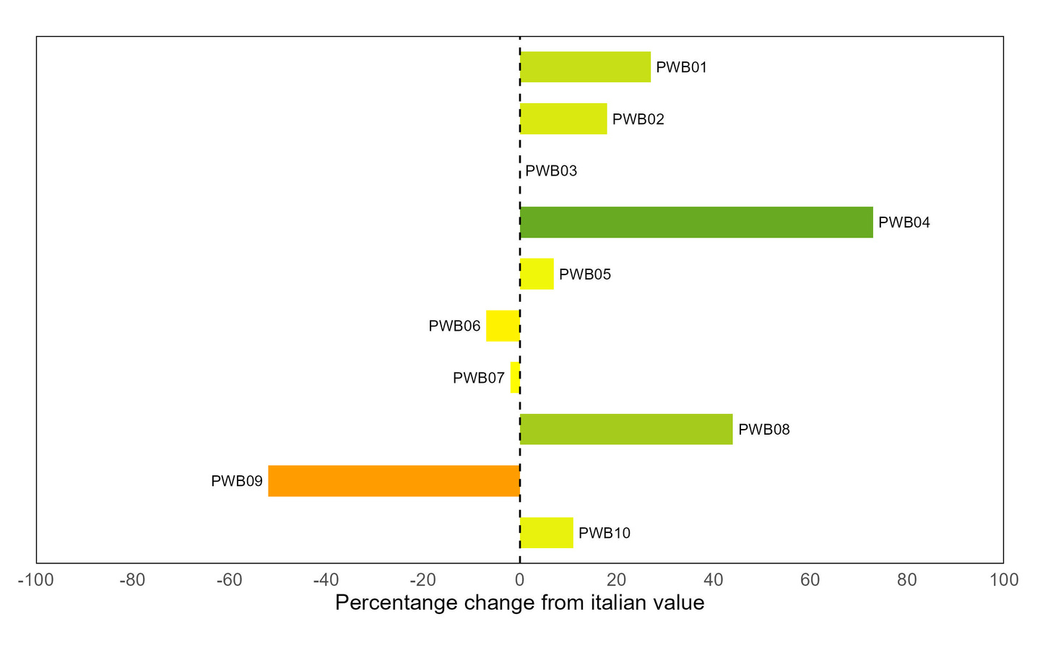

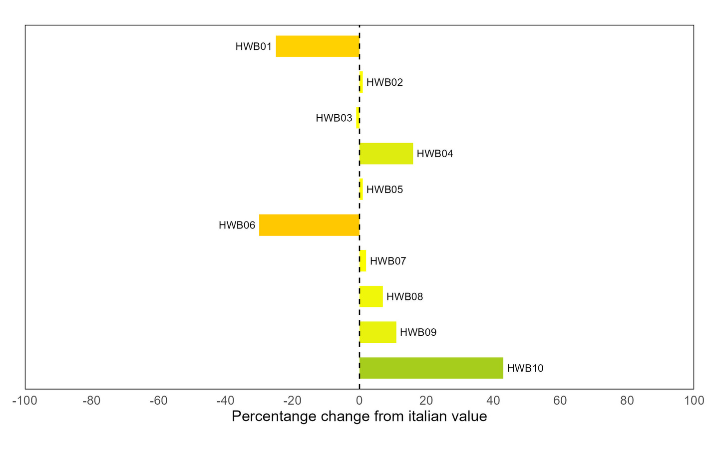
Planetary Well-being
Human Well-being
PWB01 | Percentage of electricity form renewable sources
PWB02 | PM 10 Annual average value
PWB03 | PM 2.5 Annual average value
PWB04 | Availability of urban greenery
PWB05 | Concern about climate change and greenhouse effect
PWB06 | Fragmentation of natural and agricultural land
PWB07 | Index of duration of hot periods
PWB08 | Operating solar power per capita
PWB09 | Share of utilized agricultural area (UAA) invested by organic crops
PWB10 | Regular users of pubblic transport
HWB01 | Alcohol (standardized rates)
HWB02 | Smoking (standardized rates)
HWB03 | Overweight or obesity (standardized rates)
HWB04 | Overweight and obesity children (6-11)
HWB05 | Mental health index (SF36)
HWB06 | Suicide (standardized rates)
HWB07 | Avoidable mortality (0-74 years)
HWB08 | Healthy life expectancy at birth
HWB09 | Population (25-34) with tertiary education
HWB10 | Jung people Not in Education, Employment, or Training (NEET)
United Nations Headquarters
New York Friday , October 31st, 2025

Slide 6

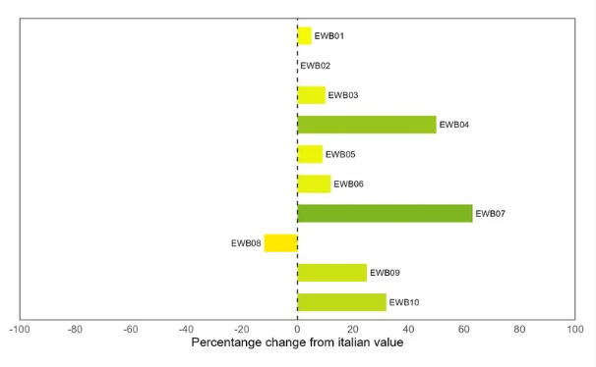

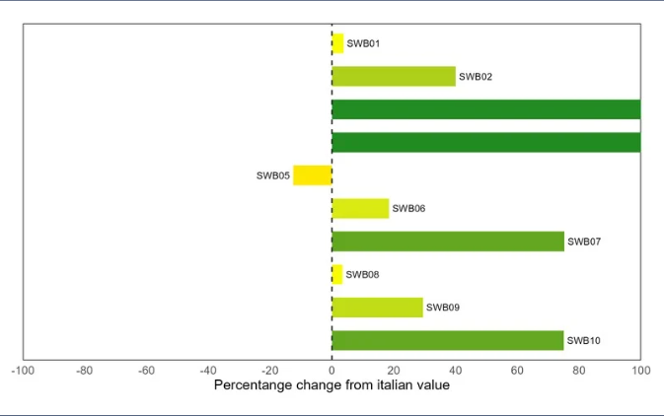
Economic Well-being
Social Well-being
EWB01 | Gross disposable income per capita
EWB02 | Innovation expenditures per person employed
EWB03 | Net income inequality
EWB04 | Uneployment rate
EWB05 | Ratio of employment rates (25-49 years old) of women with preschool-aged children and women without children
EWB06 | Reserach intensity
EWB07 | Risk of poverty or social exclusion
EWB08 | Transitions from unstable to stable jobs
EWB09 | Rate of occupational fatalities and accidents with permanent disability
EWB10 | Irregular workers (percentage)
SWB01 | Perception of the risk of crime
SWB02 | Satisfaction with one’s life
SWB03 | Positive assessment of future prospects
SWB04 | Volunteering
SWB05 | Social partecipation
SWB06 | Civic and political participation
SWB07 | Trust in law enforcement and firefighters
SWB08 | Voter turnout
SWB09 | Women victims of violence reported to the anti-violence and stalking hotline 1522
SWB10 | Foreign inmates on 100 inmates
United Nations Headquarters
New York Friday , October 31st, 2025

Slide 7
Direzione centrale salute, politiche sociali e disabilità
Welfare
United Nations Headquarters
New York Friday , October 31st, 2025

Slide 8

WELL BEEING ECONOMY LAB: COMPARING POLICIESWORK ORGANIZATION
 | Multinational Company | Multinational industry under mixed control (70% State and 30% international) | Public Administration | Small & Medium sized Company | Micro-Artisan Company
Smart Working | X | X | X | X
Short Friday | X
Smart Working in August | X

Slide 9

WBE - FAMILY SUPPORTING POLICIES
 | Multinational Company | Multinational industry under mixed control (70% State and 30% international) | Public Administration | Small & Medium sized Company | Micro-Artisan Company
Paternal leave | X | X | X | X
Extension of parental leave up to 13 years of age | X |  | X | To be assessed upon request
Extra permits (e.g., pediatric visits) | X | X | X |  | X
Smart Working for new parents (up to one year) | X | X
Contribution to daycare centers | X | X
Scholarship contribution |  | X | X
Time bank |  | X
“Dogs at work” |  |  | X
Reduced hours for breastfeeding during the first year |  | X | X | To be assessed upon request | X

Slide 10

WBE - COMPANY POLICIES & GENDER EQUALITY
 | Multinational Company | Multinational industry under mixed control (70% State & 30% international) | Public Administration | Small & Medium sized Company | Micro-Artisan Company
Gender equality policies | X | X
Corporate sustainability policies |  | X | X
Environmental protection initiatives or sustainable practices | X | X |  | X
Facilitation of cycling mobility | X | X

Slide 11
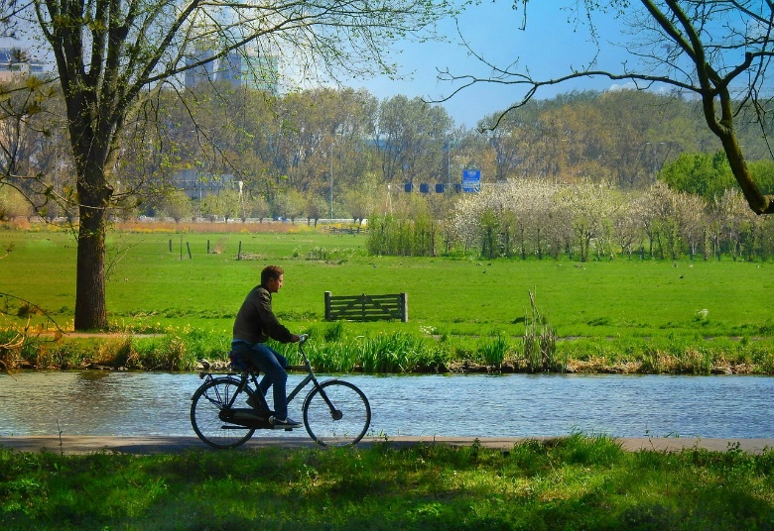
WBE PROMOTING HEALTH & PREVENTION ACTIVITIES FOR EMPLOYEES
 | Multinational Company | Multinational Industry under mixed control (70% State & 30% international) | Public Administration | Small & Medium sized Company | Micro-Artisan Company
Integration of social and health services | X | X | X | X | X
Company gym or sports activities facilitations | X | X |  | X
Nutritional Counseling | X | X |  | X
Activation of walking groups | X
Vaccination Offer | X | X
Anti-smoking/addiction programs |  |  |  | X

Slide 12
Direzione centrale salute, politiche sociali e disabilità
Healthy Ageing
The Friuli Venezia Giulia region is experiencing an unprecedented demographic winter; the number of elderly people is significant, as is the dependency ratio, which exceeds 36%, and not even immigration is able to reverse this trend.
It was the first in Italy to adopt a law on Active Aging and against loneliness (2014), which includes a three-year plan to fund NGOs that develop innovative projects for older people.
United Nations Headquarters
New York Friday , October 31st, 2025

Slide 13

Direzione centrale salute, politiche sociali e disabilità
United Nations Headquarters
New York Friday , October 31st, 2025

Slide 14

Sensitivity towards formal & informal caregivers

Slide 15
Live case
first & second Phase
The Challenges of people with Parkinson disease, their families, & caregivers
United Nations Headquarters
New York Friday , October 31st, 2025

Slide 16
Direzione centrale salute, politiche sociali e disabilità
The result of the work carried out over recent months since the original Live Case in June 30th is not only the material actions and impact, but the evolution to a different level of challenges and an inclusive process that is result in itself.

Slide 17
An example of the impact
of
innovative policies
on
vulnerable families
United Nations Headquarters
New York Friday , October 31st, 2025

Slide 18
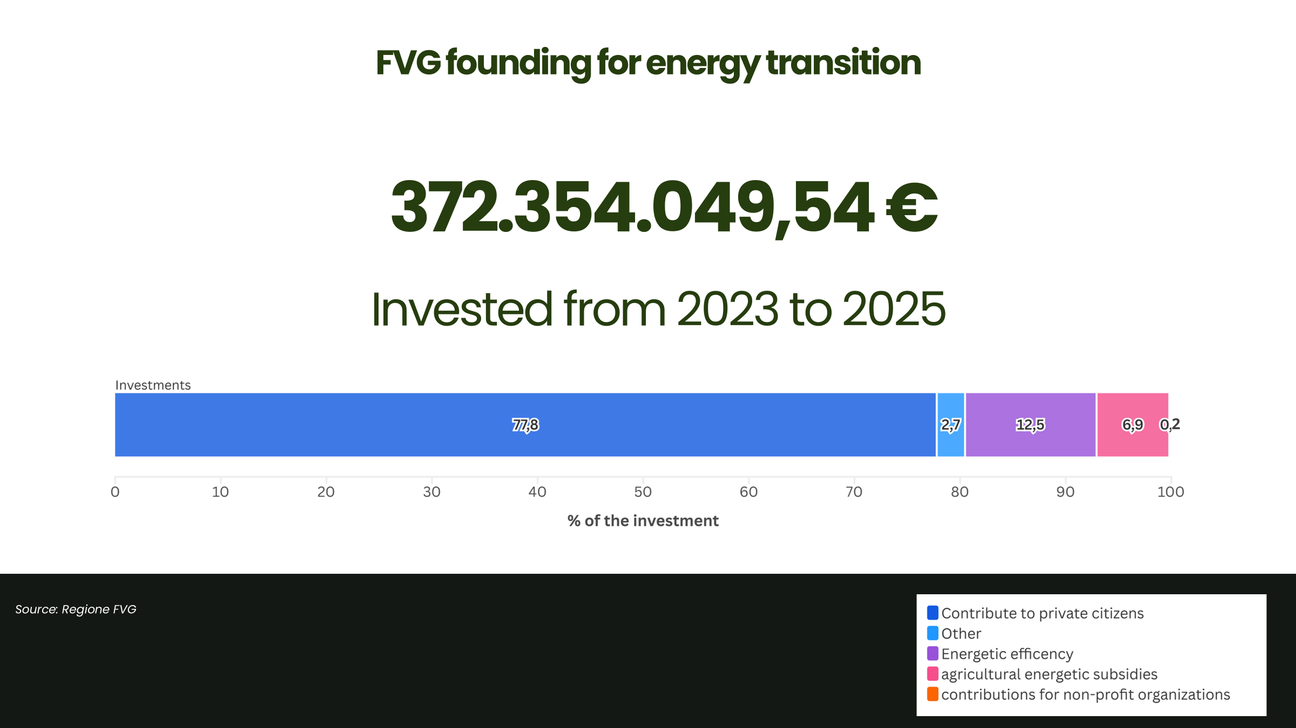
Direzione centrale salute, politiche sociali e disabilità
The impact of the energy transition on vulnerable households
United Nations Headquarters
New York Friday , October 31st, 2025

Slide 19
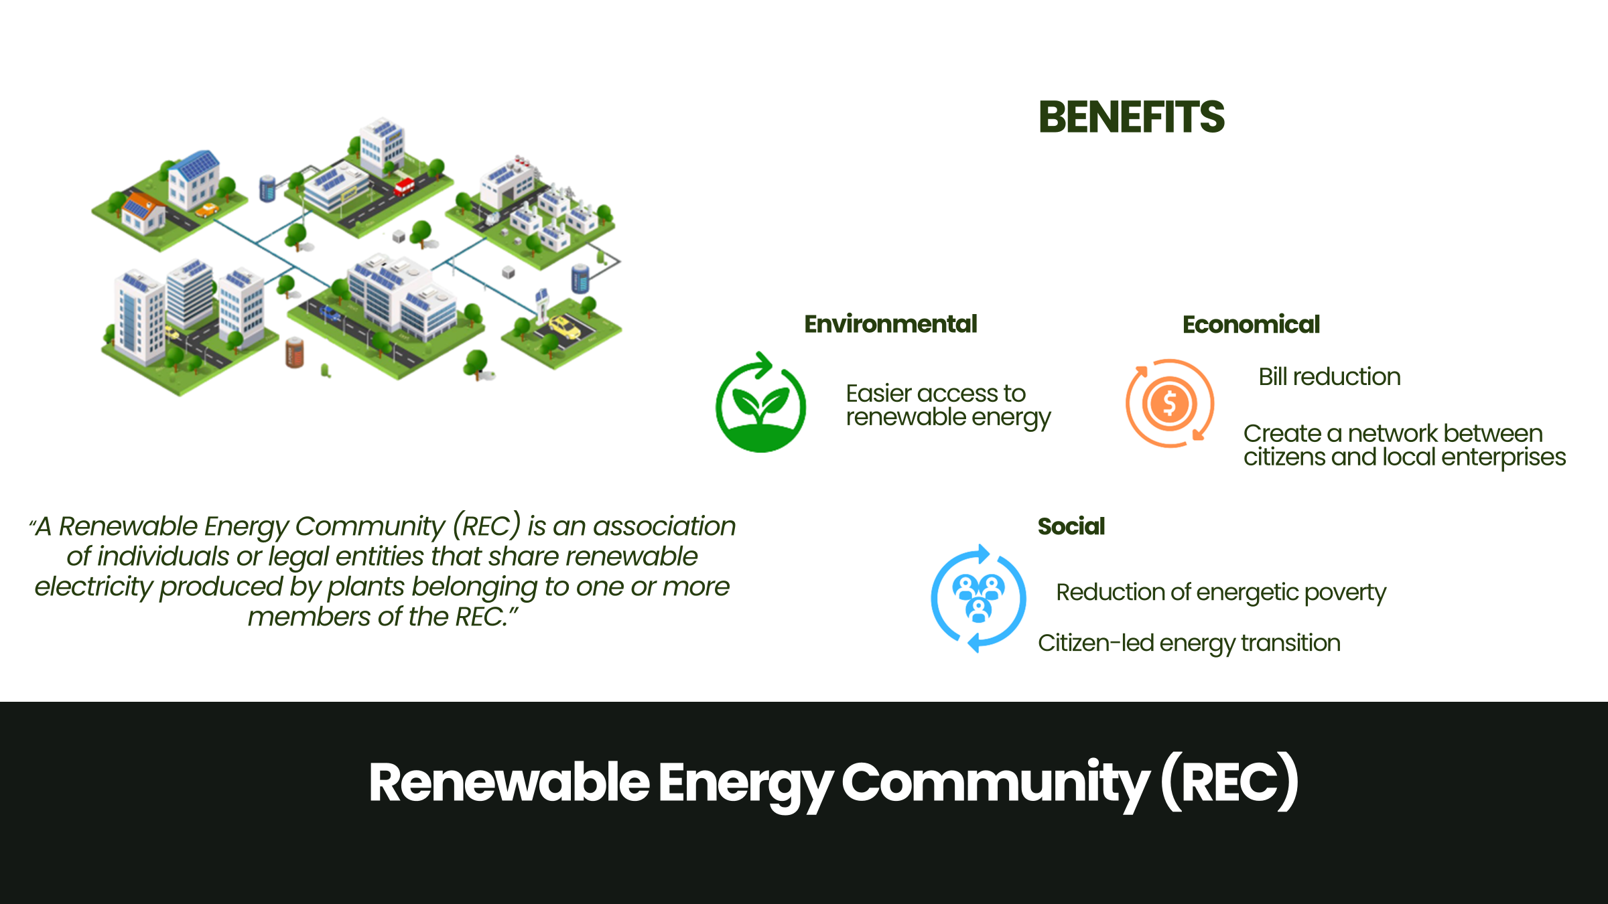
Direzione centrale salute, politiche sociali e disabilità
The impact of the energy transition on vulnerable households
United Nations Headquarters
New York Friday , October 31st, 2025

Slide 20
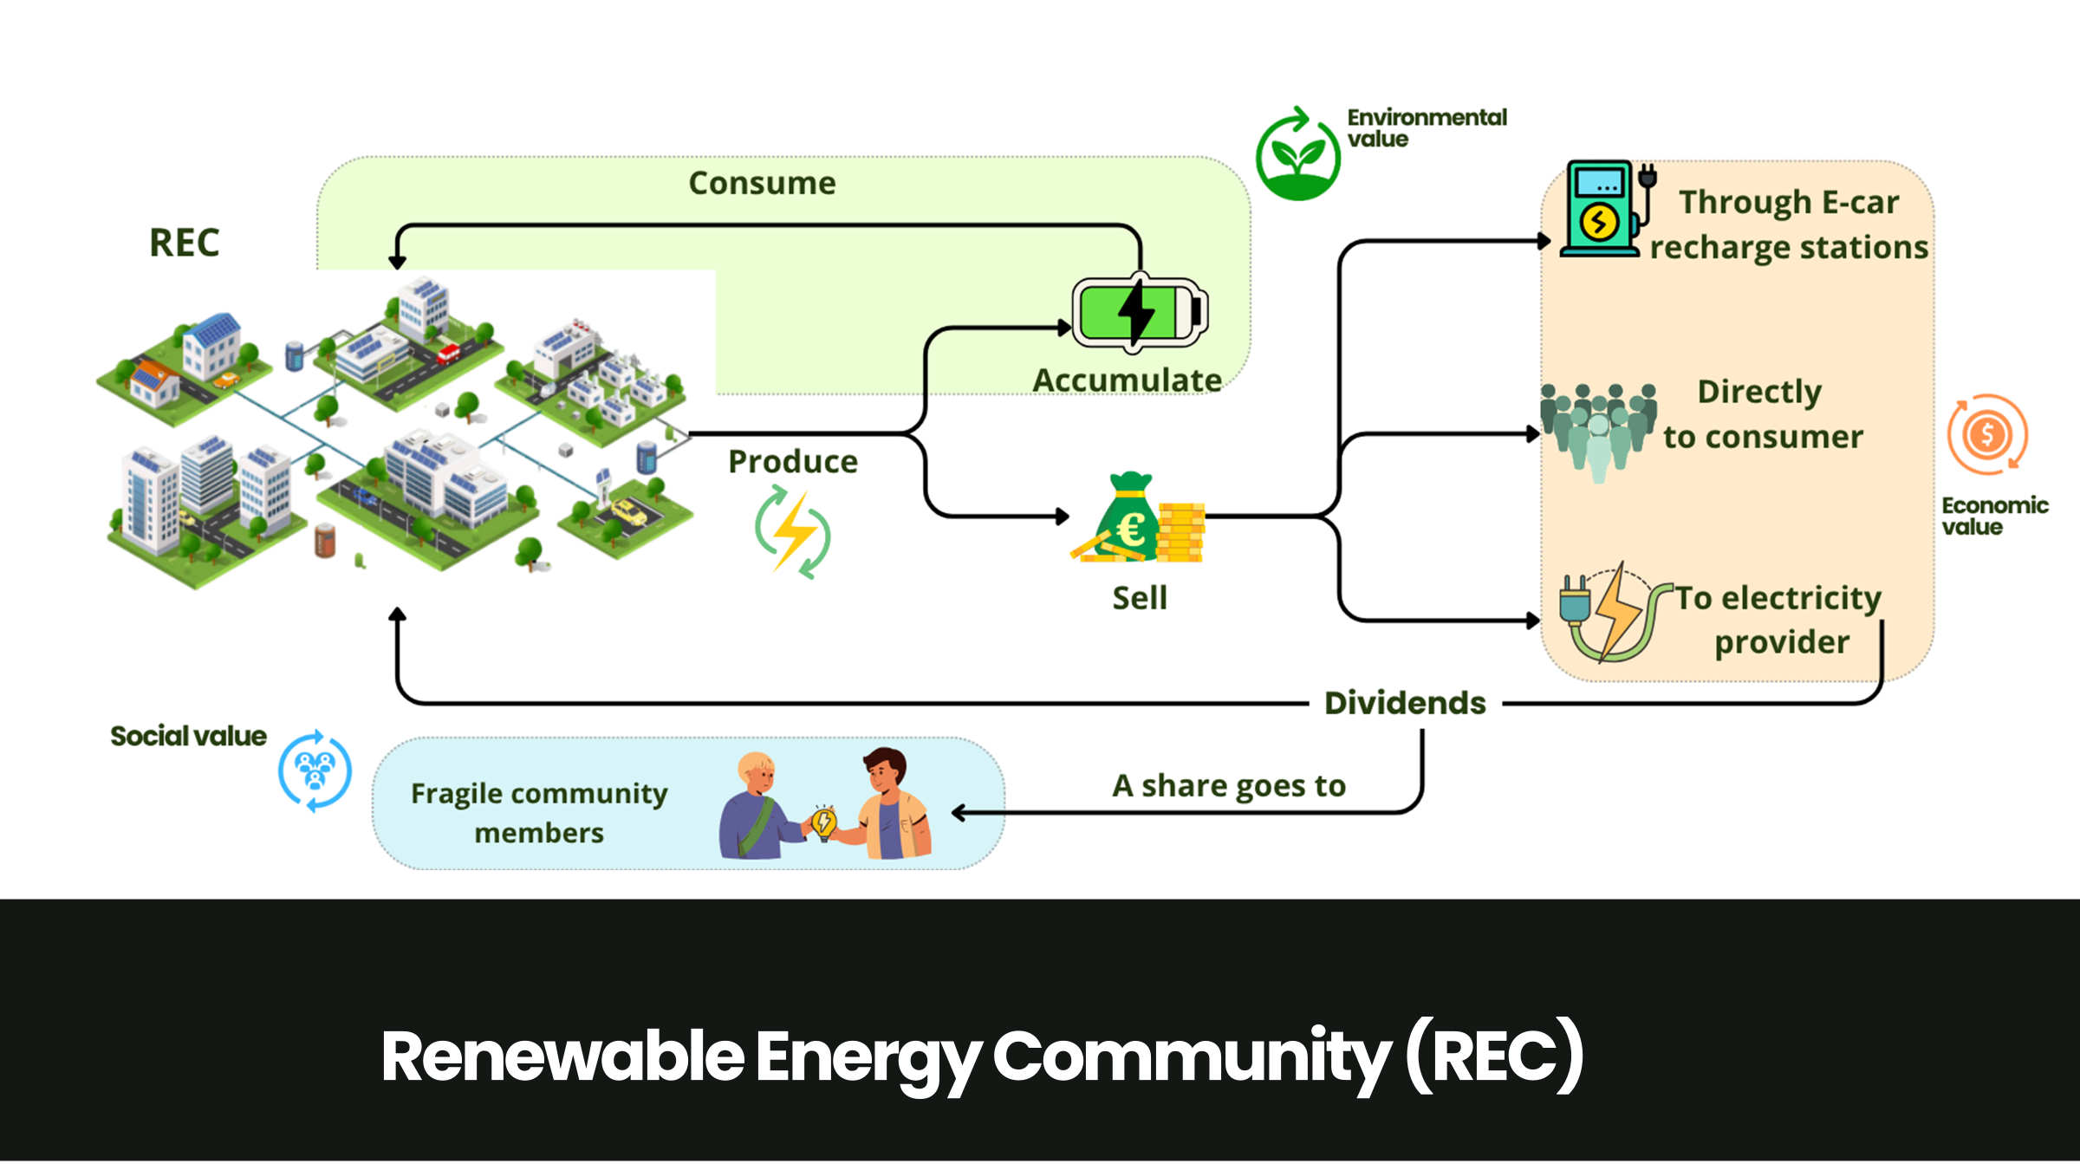
Direzione centrale salute, politiche sociali e disabilità
The impact of the energy transition on vulnerable households
United Nations Headquarters
New York Friday , October 31st, 2025

Slide 21
Direzione centrale salute, politiche sociali e disabilità
Recommendations/Remarks
To take care of families and vulnerable people, we need to:
know our territory (city, region, etc.)
develop a local network made up not only of institutions but also of voluntary associations, companies and citizens in order to understand needs
listen to people
share programs, projects, and actions
inform politicians about our work and convince them to invest where it is most needed
convince politicians to include programs, projects, and actions in their electoral agenda
United Nations Headquarters
New York Friday , October 31st, 2025

